Slide 1
Lab 2
Other methods for running C++ project
Spring 2023

Slide 2
Outline
makefile and command lines for C++ project
Getting Started with CLion for Mac and Linux

Slide 3

Run .cpp files in terminal with g++
Installation:
Linux: sudo apt-get update Mac: install Xcode first
sudo apt-get install g++
Compile the project with g++ and output the executable program like g++ YOURFILENAME.cpp -o YOURTARGETFILE
example: g++ hello.cpp -o hello
Run the executable program
example: ./hello

Slide 4
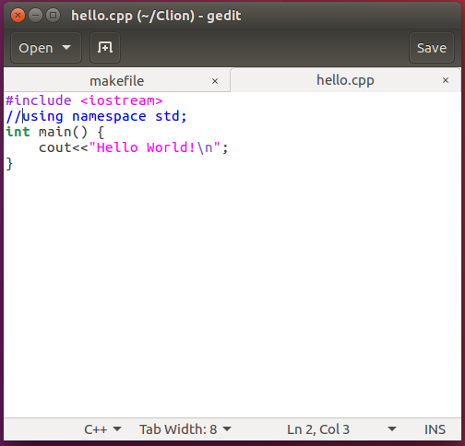
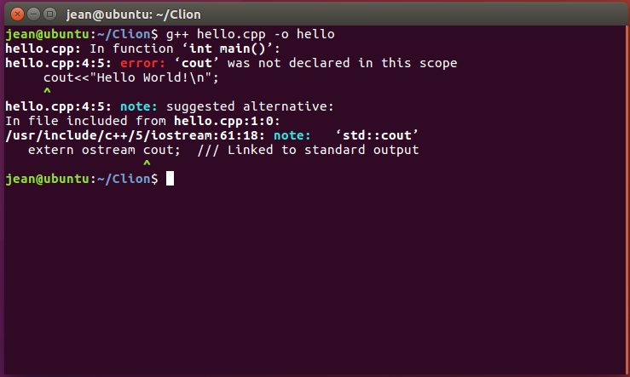
Debug with g++
Compile again
Comment this line
Error in line 4 column 5
Suggestion to fix the error

Slide 5
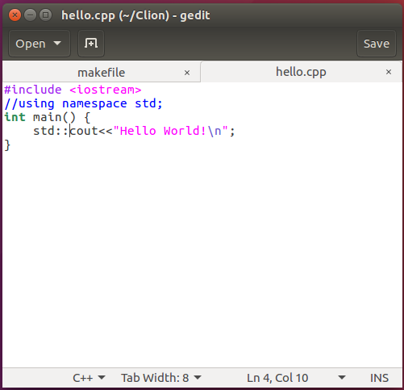
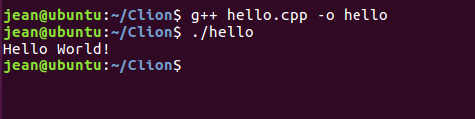
Fix error and rebuild
Any alternative method without typing such long command again?
Add std:: as suggested

Slide 6
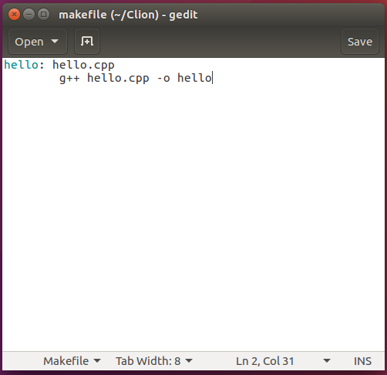

Makefile
A makefile is a file containing instructions for how to automatically build your programs. It is convenient to compile multiple programs and revised code without entering argument in command line.
An example of makefile for compile hello.cpp (write the command in last slide into make file).

Slide 7
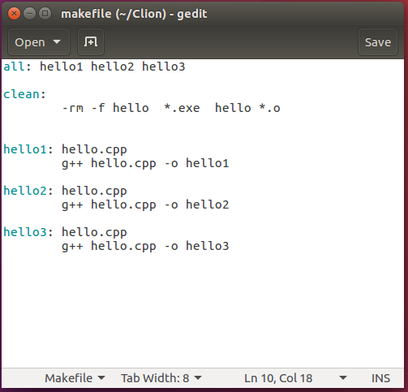
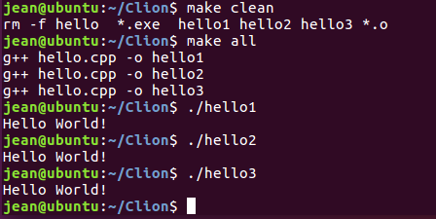
Makefile
Makefile will be very useful when you need to compile multiple files especially with dependencies.
An example of compiling hello.cpp to three different executable programs.

Slide 8
Reference:
For more rules to write the makefile, please refer to the following link or search in Google.
https://help.eclipse.org/mars/index.jsp?topic=%2Forg.eclipse.cdt.doc.user%2Fconcepts%2Fcdt_c_makefile.htm

Slide 9
Outline
makefile and command lines for C++ project
Getting Started with CLion for Mac and Linux

Slide 10
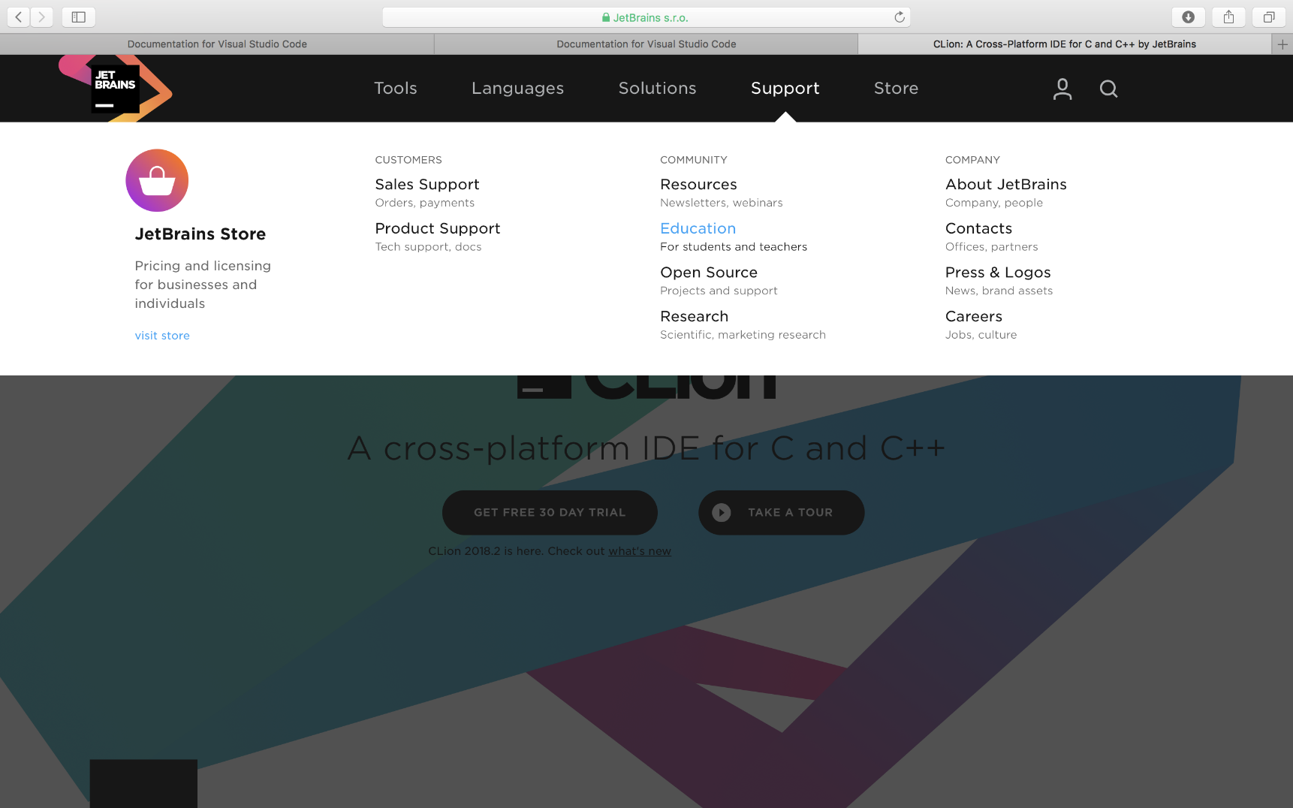
Apply the education support
Click Support
Click Education
Then following the application steps to register with your school email, you will get an education account.

Slide 11
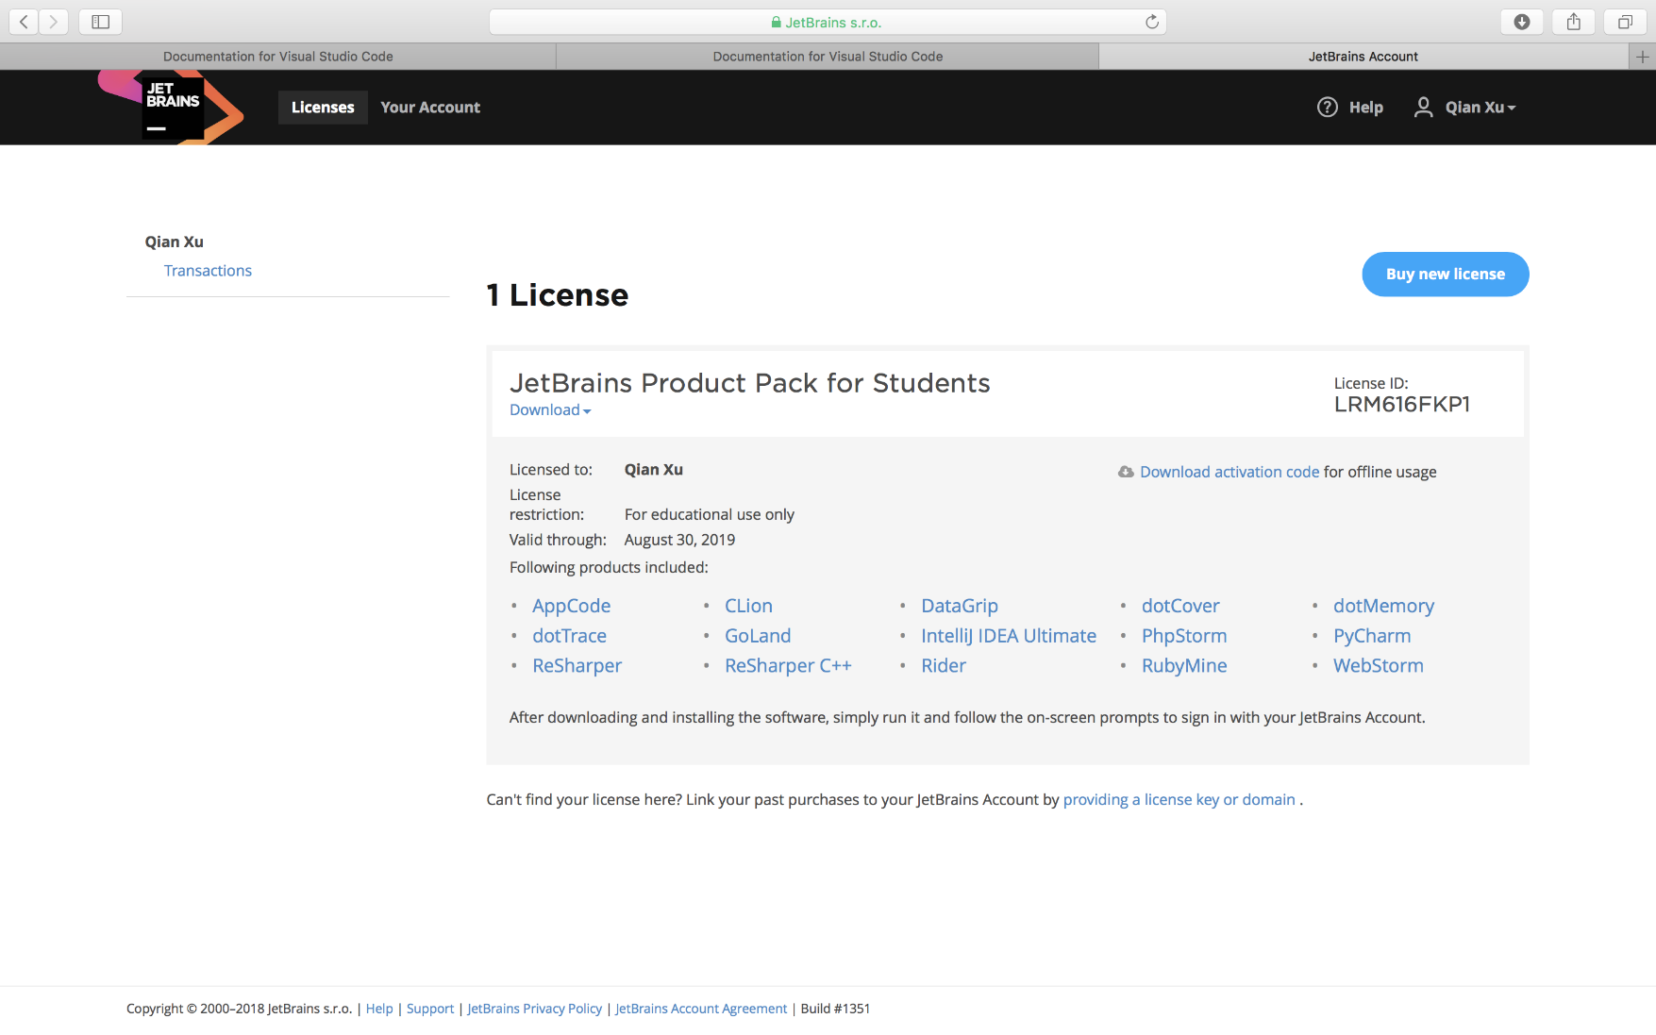
Download CLion
Click CLion
Install Clion as well as Xcode in your Mac. Active it with your username and password registered just now.

Slide 12
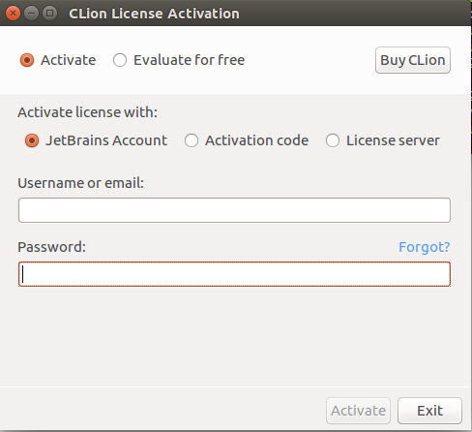
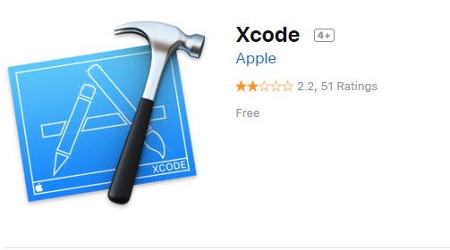
Install and Activate -- Mac
Install Xcode in your Mac.
https://itunes.apple.com/hk/app/xcode/id497799835?mt=12
Install Clion and Activate it.
Activate it with your CLion education account for free use.

Slide 13
Install and Activate -- Linux
1. Unpack the CLion-*.tar.gz file you have downloaded to the filesystem hierarchy standard (FHS) /opt (recommend)
sudo tar xf CLion-2018.2.2.tar.gz -C /opt/
2. Switch to the bin directory
cd /opt/clion-2018.2.2/bin
3. Run CLion.sh from the bin subdirectory.
sudo chmod +x clion.sh
./clion.sh

Slide 14
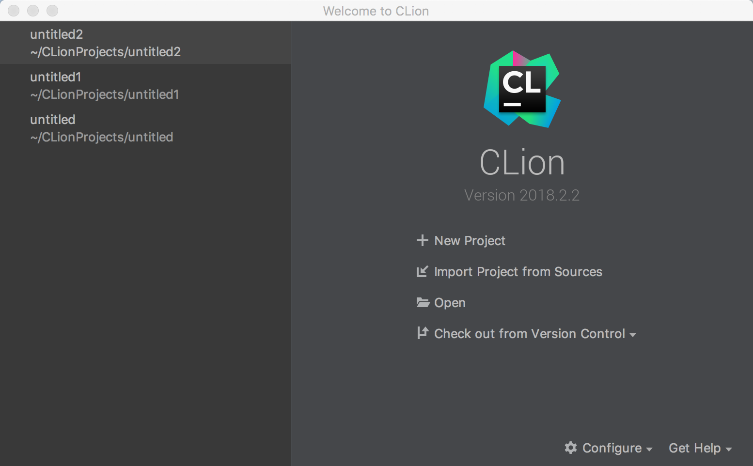
Open a new project
Click New Project

Slide 15
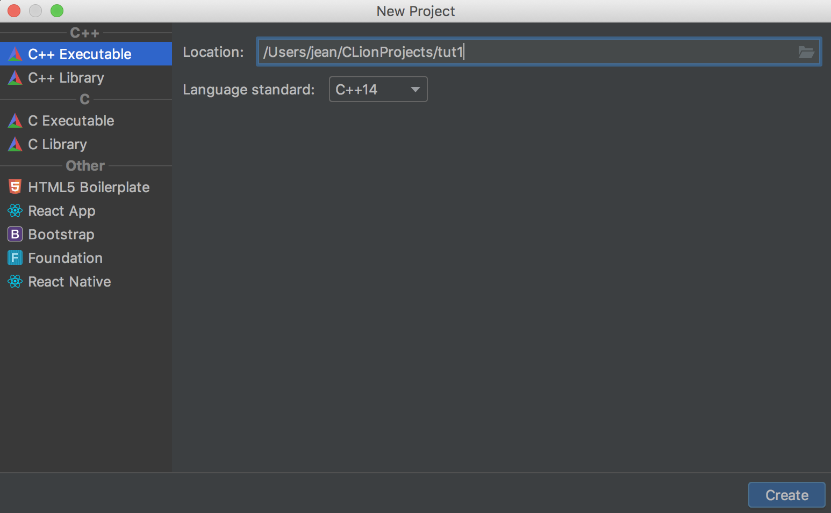
Choose C++ Executable
Locate and name your project

Slide 16
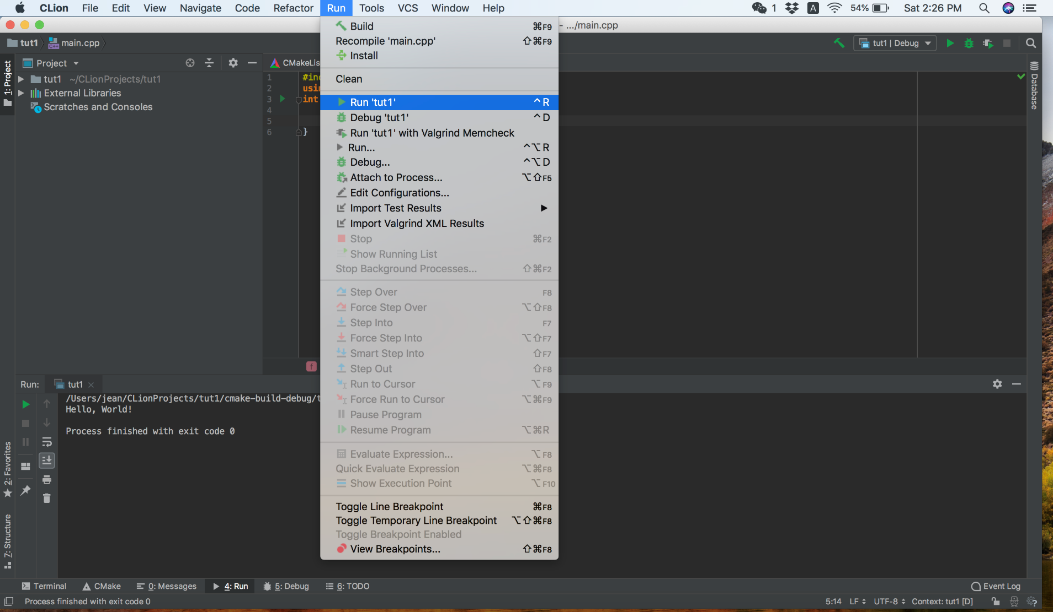
Run the program

Slide 17
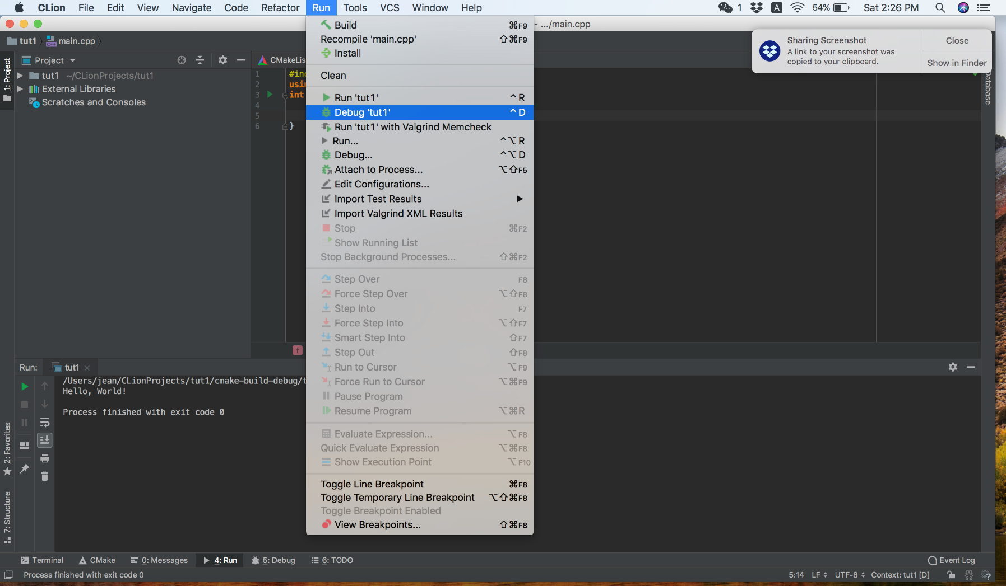
Debug the program

Slide 18
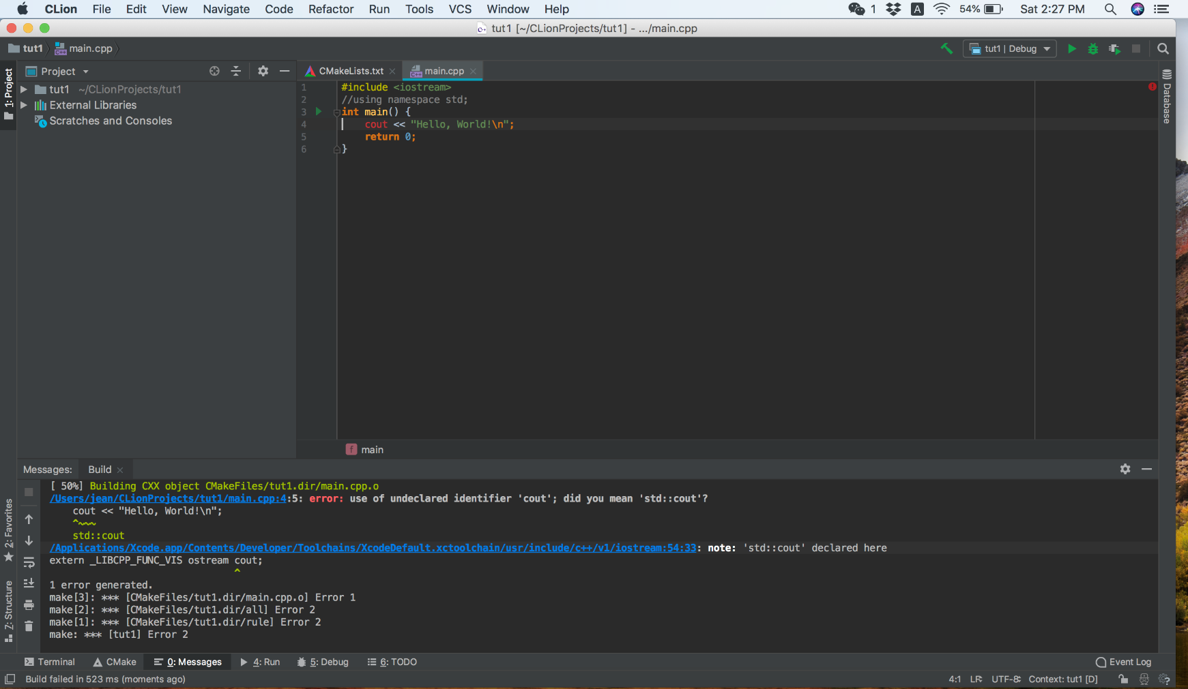
Debug the program
The line with error
Click the error

Slide 19
Reference
https://www.jetbrains.com/help/clion/install-and-set-up-product.html

Slide 20
Exercise 1
Under different environments
Create a C++ project
Complete the Hello world program

Slide 21
Exercise 2 – Output the following
In C++, "\" indicates an escape sequence.
For example, "\n" will output a new line, and "\\" will output the backslash character "\" itself.
Escape sequences are used to represent certain special characters (e.g. \n, \, “”) within string literals (e.g. cout << “”) and character literals.

